Slide 1

The state of criminal justice regarding European funds protection in Slovak republic
Project “2024-IT-PIF” (GA no. 101193934), co-funded by the EU (EUAF-2024-TRAI)

Slide 2
Ranges of damages in Slovak Criminal Law
Legal definition | Range
Small damage | 700,01 € - 20.000,00 €
Greater damage | 20.000,01 € - 250.000,00 €
Considerable damage | 250.000,01 € - 650.000,00 €
Large-scale damage | > 650.000,01 €

Slide 3
Statute of limitations in Slovak
Criminal Law
(general)
Imprisonment for over 10 years
Range of possible imprisonment for the crime | Length of the Statute of the limitations
Life sentence | 30 years
Imprisonment for over 10 years | 15 years
Imprisonment for over 5 years | 10 years
Imprisonment for over 3 years | 5 years
Imprisonment for less than 3 years | 3 years
Statute of limitations in Slovak
Criminal Law
(EU finances)
Range of possible imprisonment for the crime | Length of the Statute of the limitations
Imprisonment for minimally 10 years | 20 years
Imprisonment for over 5 years | 10 years
Imprisonment for minimally 3 years | 5 years
Imprisonment for less than 3 years | 3 years

Slide 4
Damage to the EU's financial interests - § 261-263 of Criminal Code

Slide 5
§ 261 Criminal Code
(1) Whoever uses or submits a false, incorrect or incomplete statement or document, or fails to provide mandatory information, thereby enabling the unlawful retention of funds or assets originating from the European Union, from the budget managed by or on behalf of the European Union or the budget of the institutions, offices and agencies of the European Union established in accordance with the Treaty on the Functioning of the European Union or the budget managed and controlled by them directly or indirectly, or of these funds or assets for a purpose other than the intended purpose, shall be punished by imprisonment for up to four years.
(2) As in paragraph 1, anyone who uses funds or other assets originating from the budget of the European Union, from a budget managed by or on behalf of the European Union or the budget of the institutions, bodies, offices and agencies of the European Union established in accordance with the Treaty on European Union or the Treaty on the Functioning of the European Union or the budget managed and controlled directly or indirectly by them for a purpose other than the intended purpose shall be punished.
(3) An offender shall be punished by imprisonment for a term of one to five years if, as an employee, member, representative or other person authorised to act on behalf of the person providing the funds or other assets referred to in paragraph 1, he enables the funds or other assets referred to in paragraph 1 to be obtained by someone he knows does not meet the conditions for their provision, or enables them to be unlawfully retained or used for a purpose other than the intended purpose.

Slide 6
§ 261 Criminal Code
(4) The offender shall be punished by imprisonment for two to six years if he commits the act referred to in paragraph 1, 2 or 3 and thereby causes greater damage, or commits it from special motive or by more serious course of action.
(5) The offender shall be punished by imprisonment for two to eight years if he commits the act referred to in paragraph 1, 2 or 3 and thereby causes considerable damage.
(6) The offender shall be punished by imprisonment for three to ten years if he commits the act referred to in paragraph 1, 2 or 3 and thereby causes large-scale damage or as a member of dangerous group.

Slide 7
§ 261 Criminal Code
Year | Number of criminal cases | Number of resolved criminal cases | Number of additionally resolved cases | Sum of damages
2006 | 3 | 0 | 0 | 2 124
2007 | 6 | 2 | 0 | 376 751
2008 | 12 | 8 | 4 | 35 086
2009 | 32 | 23 | 3 | 225 000
2010 | 55 | 40 | 4 | 2 723 000
2011 | 46 | 31 | 6 | 6 310 000
2012 | 65 | 42 | 7 | 27 658 000
2013 | 64 | 22 | 12 | 3 368 000
2014 | 60 | 31 | 16 | 1 465 000
2015 | 45 | 28 | 17 | 3 301 000
2016 | 50 | 31 | 16 | 6 068 000
2017 | 43 | 14 | 16 | 7 112 000
2018 | 32 | 16 | 12 | 695 000
2019 | 41 | 14 | 9 | 2 137 000

Slide 8
§ 261 Criminal Code
Year | Number of criminal cases | Number of resolved criminal cases | Number of additionally resolved cases | Sum of damages
2020 | 45 | 14 | 14 | 666 000
2021 | 63 | 15 | 11 | 4 294 000
2022 | 37 | 13 | 17 | 2 278 000
2023 | 24 | 8 | 12 | 4 324 000
2024 | 32 | 6 | 14 | 5 146 000
2025 | 42 | 6 | 9 | 71 962 000
TOTAL: | 797 | 364 | 199 | 150 145 961

Slide 9
§ 262 Criminal Code
(1) Whoever violates or fails to fulfill an obligation arising from his employment, profession, position or function in the management or control of the activities of persons managed by him, and thereby enables the commission of a criminal offence under Section 261, paragraph 1, shall be punished by imprisonment for up to two years.
(2) The offender shall be punished by imprisonment for one to four years if he commits the act referred to in paragraph 1 and thereby causes greater damage.
(3) The offender shall be punished by imprisonment for one to five years if he commits the act referred to in paragraph 1 and thereby causes considerable damage.

Slide 10
§ 262 Criminal Code
Year | Number of criminal cases | Number of resolved criminal cases | Number of additionally resolved cases | Sum of damages
2021 | 1 | 0 | 0 | 0
2024 | 3 | 0 | 0 | 0

Slide 11
§ 263 Criminal Code
(1) Whoever negligently damages the financial interests of the European Union by acting in accordance with Section 261(1) shall be liable to a term of imprisonment of up to one year.
(2) The offender shall be punished by imprisonment up to two years if he commits the act referred to in paragraph 1 and thereby causes considerable damage.

Slide 12
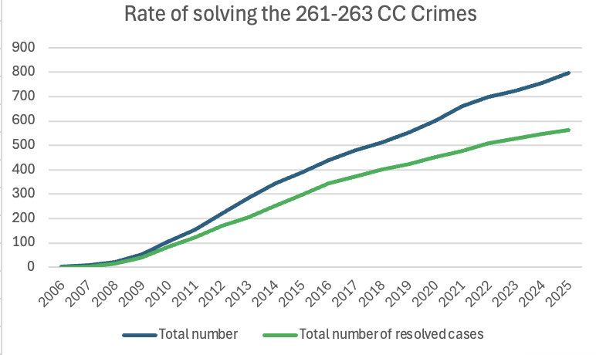

Slide 13
VAT Frauds - § 277a of Criminal Code

Slide 14
§ 277a
Criminal Code
(1) Whoever unlawfully claims a refund of VAT or excise tax to a greater extent with the intention of obtaining an unjustified benefit for himself or another shall be punished by imprisonment for six months to three years.
(2) The offender shall be punished by imprisonment for two to eight years if he commits the act referred to in paragraph 1 and was convicted before for the same crime, or to a considerable extent, or by more severe coarse of action.
(3) The offender shall be punished by imprisonment for three to ten years if he commits the act referred to in paragraph 1 and thereby causes large-scale damage or as a member of a dangerous group.

Slide 15
§ 277a Criminal Code
Year | Number of criminal cases | Number of resolved criminal cases | Number of additionally resolved cases | Sum of damages
2012 | 9 | 1 | 0 | 284 000
2013 | 60 | 18 | 4 | 4 493 000
2014 | 96 | 24 | 15 | 12 875 000
2015 | 100 | 16 | 20 | 21 369 000
2016 | 96 | 26 | 21 | 9 742 000
2017 | 116 | 33 | 21 | 6 588 000
2018 | 61 | 15 | 24 | 5 492 000
2019 | 44 | 12 | 14 | 2 553 000
2020 | 50 | 6 | 10 | 2 780 000
2021 | 50 | 10 | 12 | 16 034 000
2022 | 43 | 9 | 8 | 6 879 000
2023 | 41 | 8 | 3 | 19 382 000
2024 | 11 | 4 | 4 | 621 000
2025 | 14 | 1 | 4 | 5 002 000
TOTAL | 791 | 183 | 160 | 114 094 000

Slide 16
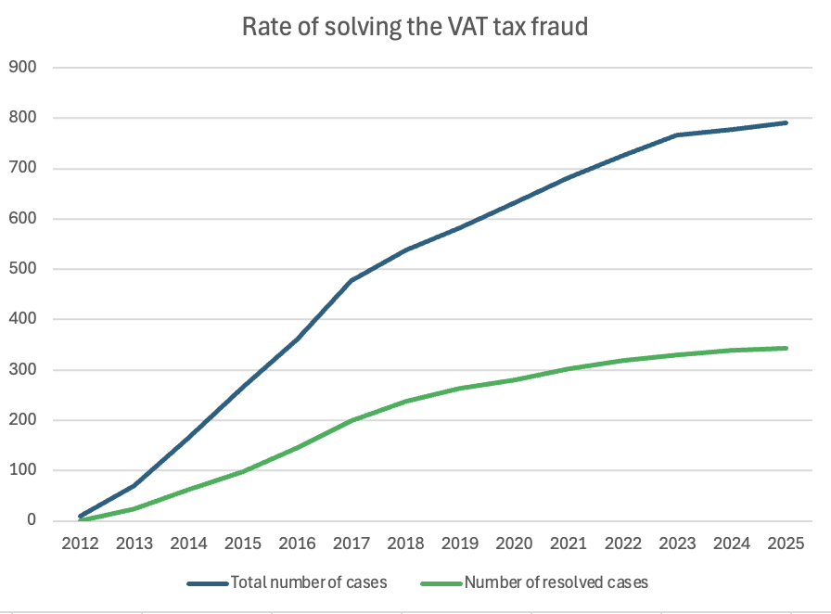

Slide 17
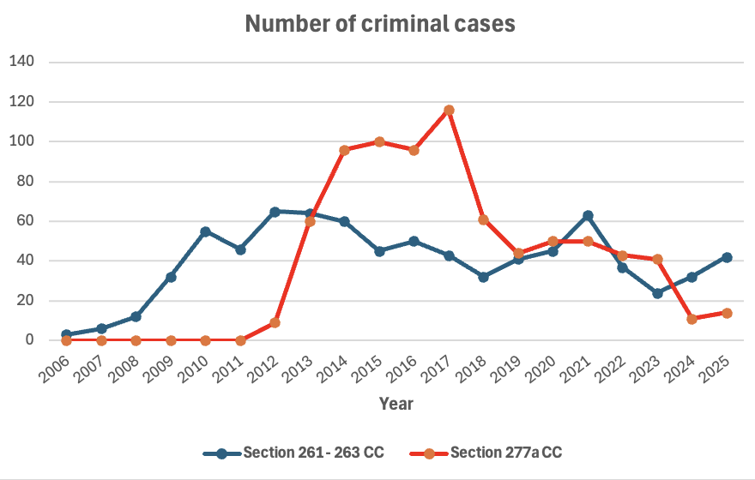

Slide 18
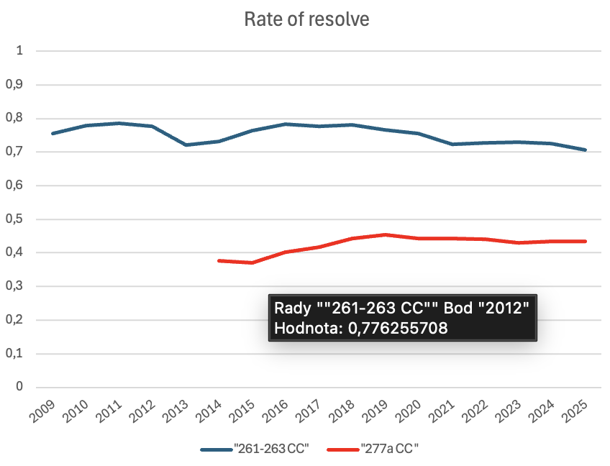

Slide 19
Thank you for your attention
tomas.stremy@flaw.uniba.sk ; ferencak4@uniba.sk

