Slide 1

Strengthening the Protection of the EU’s Financial Interests via Criminal Law
Project “2024-IT-PIF” (GA no. 101193934), co-funded by the EU (EUAF-2024-TRAI)

Slide 2
Context and Objectives
Analysis of Portuguese transposition of the PIF Directive -(EU) 2017/1371
Protection of the EU’s financial interests (EUFI)
Focus on subsidy fraud

Slide 3
The PIF Directive
Directive (EU) 2017/1371
Establishes minimum criminal-law protection of EUFI
Requires effective, proportionate and dissuasive criminal sanctions

Slide 4
Article 3 – Core Criminalisation
Fraud subsidies - four areas to be protected (subparagraphs of Article 3(2)):
Public procurement not related expenditure
Procurement-related expenditure
Revenues other than derived form VAT own resources
Revenues derived from VAT own resources

Slide 5
Forms of Criminal Conduct
Three categories:
Active conduct (false/inaccurate documents) - (points (i) of subparagraphs (a) to (d) of Article 3(2) of the Directive)
Omission (breach of specific obligations to disclose information) - (points (ii) of subparagraphs (a) to (d) of Article 3(2) of the Directive)
Misapplication of funds/benefits legally obtained - (points (iii) of subparagraphs (a) to (c) of Article 3(2) of the Directive)

Slide 6
Portuguese Legal Framework
Fragmented regulation across:
Decree-Law No. 28/84 (Anti-Economic Offences) – Articles 36, 37-A and 72-A
Legal Regime of Tax Offences (R.G.I.T.) – Articles 103 and 104
Criminal Code (general rules)

Slide 7
Article 36 – Fraud in Obtaining Subsidies
Covers fraudulent obtaining of subsidies -Corresponds, to some extent, to points (i) and (ii) of subparagraphs (a) to (c) of Article 3(2) of the Directive)
Indirect protection - Legal interest protected via economic trust and correct application of public funds in the economic sphere
No explicit reference to EU financial interests

Slide 8
Assessment of Article 36
Dogmatically insufficient for PIF purposes
Focus on national economic order
EU interests protected only through case law

Slide 9
VAT Own Resources and Tax Fraud
Regulated under R.G.I.T. (Article 104) - correspond almost entirely to Article 3(2)(d) of the Directive
Cover evasion and undue tax advantages
No explicit EU reference

Slide 10
Assessment of VAT Protection
Focus on national tax system - cover tax offences relating to the various types of taxes
EU interests protected indirectly, through case law

Slide 11
Article 37-A – Misuse of EU Revenues
Criminalizes and punishes misappropriation of EU non-VAT funds - Corresponds, to some extent, to points (iii) of subparagraphs (a) to (c) of Article 3(2) of the Directive)
Newly created to assure Directive transposition Explicit protection of EU revenues
EU legal interest protected autonomously

Slide 12
Significance of Article 37-A
Functional protection of EU budget
Independent of national financial loss
Only provision directly aligned with PIF model, as it protects EU revenues by themselves

Slide 13
Preliminary conclusion
The incrimination regarding misapplication of funds/benefits legally obtained is the only that protects directly the EU financial interests
The other situations foreseen in article 3 - fraudulent obtaining of subsidies and VAT own resources fraud are only indirectly protected

Slide 14
Sanctions – Article 7 PIF Directive
Foresees imprisonment as maximum penalty (2) and at least 4 years of imprisonment when considerable damage occurred (3)
Article 36 of Anti Economic Offences Law and Article 104 of Legal Regime of Tax Offences: foresee up to 8 years imprisonment - article 7- (1)(2)(3)
Article 37-A: thresholds up to 2 years (damage €10k / €100k) and to 5 years imprisonment (damage over €100k) - article 7- (4)
Administrative offence below €10k - article 7- (4)

Slide 15
Proportionality of Sanctions
Compliance with Directive thresholds
Respect for subsidiarity of criminal law
Adequate deterrent effect

Slide 16
Forms of participation and Attempt – Article 5 PIF Directive
Incitement, aiding and abetting governed by Penal Code – Provided for by law in Articles 26 and 27 - article 5- (1)
Attempt always punishable (anti-economic offences) – Articles 23 of Penal Code and 4 of Anti-Economic Offences law - article 5- (2)
Compliance with Article 5

Slide 17
Liability of Legal Persons – Articles 6 and 9 PIF Directive
Criminal liability of legal persons ensured, when offense committed by representatives, in their name and in their interest
Applicable to both anti-economic and tax offences
Stipulated sanctions aligned with Article 9

Slide 18
Criminal Organisation – Article 8 PIF Directive
Establishes criminal organisation as an aggravating circumstance
No specific provision in Portuguese law
Criminal Association as an autonomous offence – more demanding requirements, but more severe. Concurrence of crimes
Partial non-compliance with Article 8

Slide 19
Freezing and Confiscation of instrumentalities and proceeds – Article 10 and - Recovery - Article13 PIF Directive
General confiscation and preventive seizure rules apply - articles 109 and 110 of Penal Code and 228 of Procedure Penal Code
Article 39 of Anti Economic Offences Law - Restitution regarding Article 36 of Anti-Economic Offences Law
Omission regarding Article 37-A and article 104 of Tax Offences Law, which weakens the intended outcome and creates an undesirable difference

Slide 20
Statute of Limitations – Article 12 PIF Directive
Limitation periods exceed Directive minimums regarding both criminal proceedings and enforcement - Article 12 (2) (4)
Periods can be extended arising suspension and interruption ensured in both situations

Slide 21
Final Remarks
Fragmented and incomplete transposition of criminal offenses
No single offence mirrors Article 3 PIF
all other requirements have been met, except regarding Criminal Organization as an aggravation

Slide 22
Final Remarks
Fragmented yet significant protection of EU financial interests
Need for systematic and EU-oriented interpretation
Central role of courts and academy in ensuring effective compliance

Slide 23
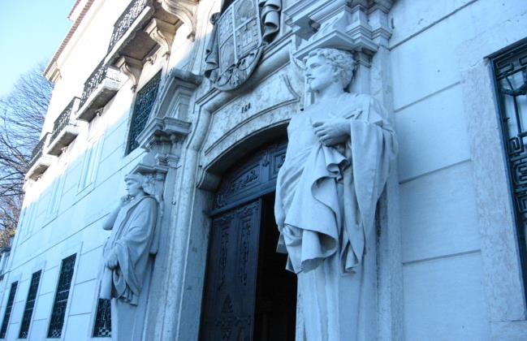
Strengthening the Protection of the EU’s Financial Interests

