Slide 1


Strengthening the protection of EU's financial interests via criminal law:
Fraud prevention and anti-corruption measures
Lithuanian practice and structural challenges
2026-02-12
Catania
1Project “2024-IT-PIF” (GA no. 101193934), co-funded by the EU (EUAF-2024-TRAI)
93934), co-funded by the EU (EUAF-2024-TRAI)
1
Notes:
1
1
1
1

Slide 2
PUBLIC OFFICIAL ART 230 (3) of the CC
A person equivalent to a public servant includes not only traditional public officials but also individuals working in public or private legal entities who:
- exercise administrative powers,
- are entitled to act on behalf of a legal entity,
- provide public services,
- as well as arbitrators and jurors.
2
2
Notes:
2
2
2
2

Slide 3
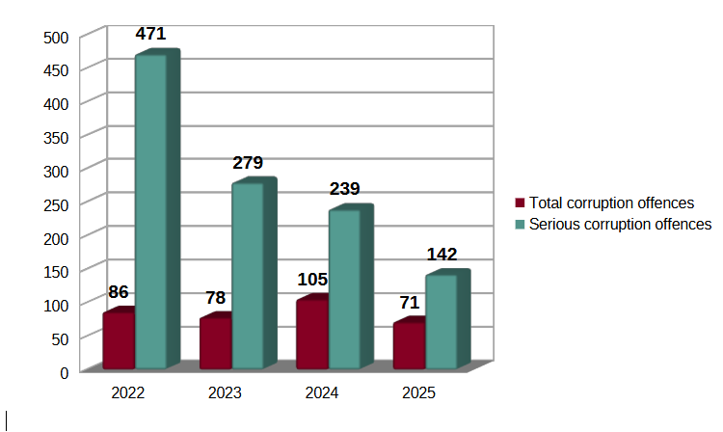
STATISTICS ON CORRUPTION
3
3
Notes:
3
3
3
3

Slide 4
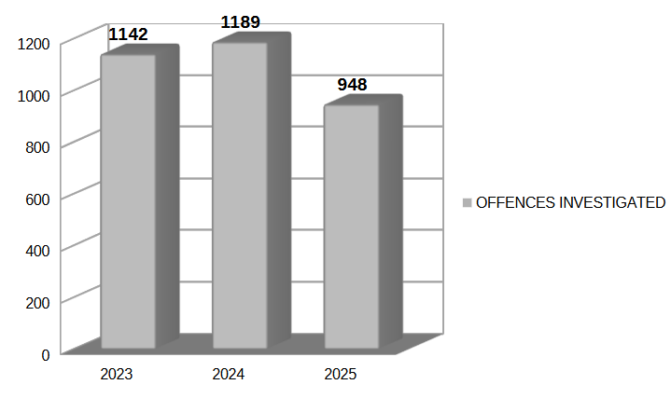
OFFENCES CAUSING SIGNIFICANT DAMAGE TO STATE AND EU FINANCIAL INTERESTS (investigations completed)
4
4
Notes:
4
4
4
4

Slide 5
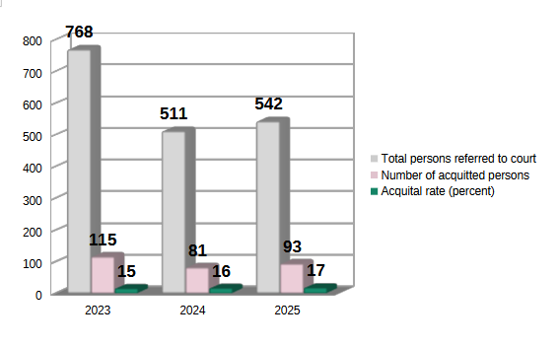
Court outcomes – offenses damaging State and EU financial interests
5
5
Notes:
5
5
5
5

Slide 6
Structural challenges in protecting EU financial interests
High degree of organised criminal activity and sophistication;
Use of multiple jurisdictions;
Rapid movement of funds across multiple accounts;
Increasing use of crypt;
Digital evidence stored in electronic devices requiring forensic expertise;
Dissipation of assets and inability to freeze funds effectively;
Lengthy financial forensic examinations;
Etc.
6
6
Notes:
6
6
6
6

Slide 7
THANK YOU
Jūratė Radišauskienė
Prosecutor
Criminal Prosecution Department
Prosecutor General's Office of the Republic of Lithuania
Jurate.Radisauskiene@prokuraturos.lt
Notes:
7
7
7
7

